Slide 1

Toolkit for a Standard
IE3102 - Enterprise Standards for Information Security
IT19029146
Eranda H.P.D

Slide 2
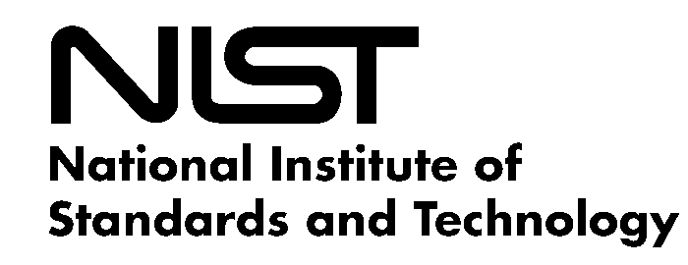
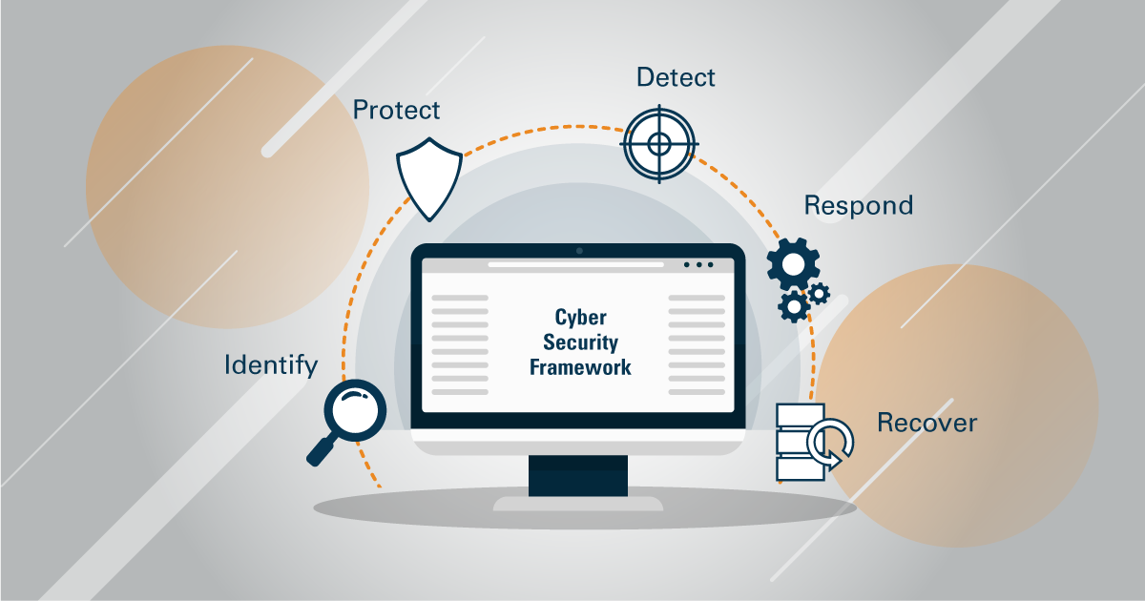
National Institute of Standards and Technology (NIST) Cybersecurity Framework

Slide 3
Abstract
Thanks Giving!
As the 3rd year 2nd semester Cyber Security undergraduates at SLIIT, under the module Enterprise Standards for Information Security (IE3102), we were asked to create a Toolkit for an IT industry standard as per our consent. After choosing a suitable topic, we are supposed to explain about that particular industry standard using a presentation deck. Then we are asked to design a complete business process of the implementation plan. Furthermore, it is expected from us to submit all the necessary documentation such as Asset Registry, Implementation Steps document, Checklists, Research documents etc.
So, the IT industry standard that I have chosen to create the Toolkit is “NIST Cybersecurity Framework ”. It is a voluntary framework that provides guidance to help organizations manage and mitigate cybersecurity risk based on existing standards, guidelines, and practices.
First of all, I would like to express my greatest gratitude to our lecturer in charge Mr. Kanishka Yapa for giving us this wonderful opportunity to enhance our knowledge & experience on various IT industry standards & its toolkits. His immense kind & consistent support helped us a lot specially in choosing a better topic for this assignment. Not only that, he also checks our assignment progress regularly in every 2 weeks of time. This has provided us with a valuable opportunity to correct our mistakes regarding this assignment.
So once again I would be very grateful for the Lecturer in Charge and associated instructors for guiding me throughout this entire assignment.

Slide 4
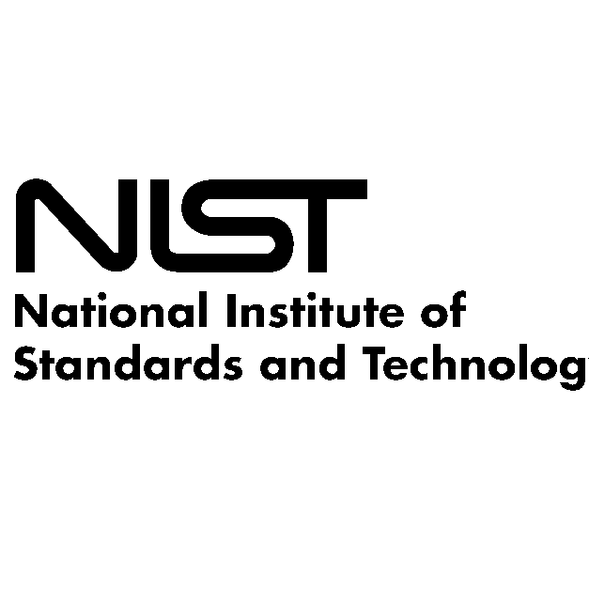
What is NIST ?
National Institute of Standards and Technology (NIST) is a non-regulatory US government agency that is responsible for generating innovation & competitiveness among the various technical industries.
NIST was found in 1901, as a non-regulatory federal agency within the U.S. Department of Commerce. Their main mission is to promote innovation and industrial competitiveness by advancing measurement science, standards, and technology in ways that enhance economic security and improve our quality of life.
One of the main roles of NIST is to develop guidelines on how companies can align with Federal Information Security Management Act (FISMA). Those guidelines were created in order to provide the utmost protection for data while preserving the cost effectiveness.
Those FISMA guidelines are very much ideal specially for government agencies, government contractors, and subcontractors since those guidelines can be applied for any organization within both public & private sectors.
According to the statistics, more than 30% of U.S. companies use the NIST Cybersecurity Framework as their standard for data protection protocol. So, it is predicted that in the future, NIST Cybersecurity Framework might act as the benchmark for cybersecurity.

Slide 5

What is NIST Cybersecurity Framework?
NIST Cybersecurity Framework is a set of voluntary standards, guidelines, and processes that companies use to diminish the risk of a cybersecurity threat.
It was designed with the intension of reducing business risks in a cost-effective way.
Currently in most of the countries, NIST Cybersecurity Framework (NIST CSF) is considered as the “Golden-Standard for building a Cyber Security Program”.
Additionally, this framework helps the organizations a lot in recovering from various cybersecurity incidents. With the help of this framework, it has become possible to identify & analyze the root cause for various cybersecurity incidents that take place.
The main highlighting point of this particular Cybersecurity Framework is its ability of properly detecting, containing & reporting a cybersecurity incident.
Furthermore, there are some procedures that are pre-set to follow in case of a sudden data breach. So, this enables an organization to respond quickly and reduce risks as much as possible.

Slide 6

Aim of the Framework
Currently, NIST Cybersecurity Framework is used by over 30% of the organizations in United States. It is predicted that it might reach 50% overall coverage at the end of the year 2020.
Following are some of the main aims of the NIST Cybersecurity Framework.
Integrate industry standards and best practices to help organizations in managing their cybersecurity risks.
Provide a common language which allows the organizational staff in developing a shared understanding of current cybersecurity risks.
Provide a proper guidance on reducing the risks.
Provide the most suitable advices on how to respond and recover from malicious attacks and learn the mitigation methods for such kind of attacks that may occur in the future.

Slide 7

Overview of the Framework
NIST Cybersecurity Framework can be divided into 3 main parts.
Framework Core
The Framework Core basically represents the a of activities, outcomes and references that detail approaches to various aspects of cybersecurity. The Framework Core consists with 5 main functions which are subdivided into 22 different categories.
Framework Implementation Tiers
The main usage of Framework Implementation Tiers is to clarify the stakeholders about various risks, the impact from those risks & the mitigation approaches that needs to be followed.
Framework Profiles
A Framework Profile is basically a list of outcomes that a particular organization has figured out through an individual risk assessment process. Those Framework Profiles are mainly used to prioritize the actions that are being taken.

Slide 8

Main Core Functions
NIST Cybersecurity Framework consists with 5 main core functions.
Identify
It looks at the current systems & data that are being used and evaluate those to identify the potential risks.
Protect
In here, it implements the appropriate safeguards to preserve the availability of the critical infrastructure services.
Detect
In this particular function, It makes the awareness within the organization about the cyber security events that may occur.
Respond
In this core function, it takes the appropriate actions for the detected cyber security events.
Recover
In the Recover function, it maintains proper recovery plans and restores the data & services that are affected by a cyber security incident.

Slide 9
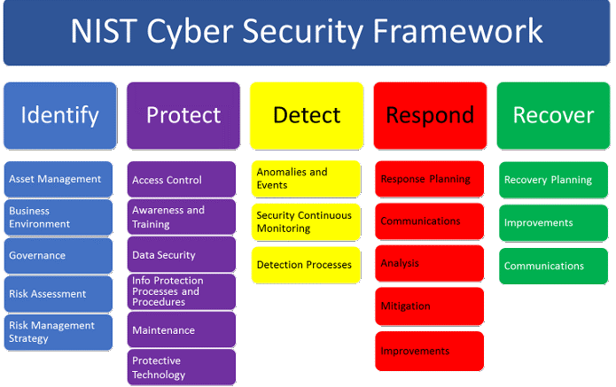
Main Core Functions
Following diagram represents the main Core Functions of the NIST Cybersecurity Framework in a nutshell.

Slide 10
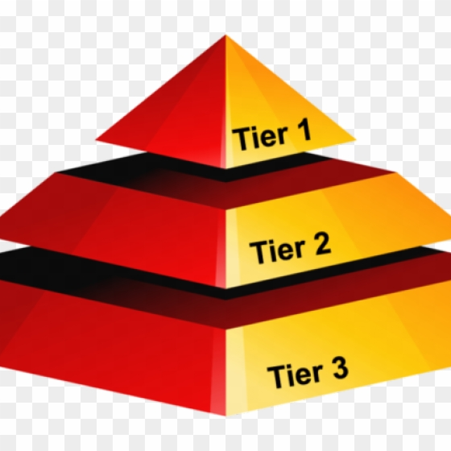
Framework Implementation Tiers
NIST Cybersecurity Framework can be divided into 4 major implementation tiers.
Partial
This tier represents the best cyber security practices that need to be followed based on the past experiences.
Risk-Informed
This tier represents the awareness of a particular organization towards various risks and appropriate plans to respond for those risks.
Repeatable
This tier represents the regularly repeatable cyber security processes that have been clearly defined.
Adaptive
This tier represents all about the proactive risk mitigation safeguards.

Slide 11

Implementation of the Framework
When it comes to the implementation stage of the framework, there 7 important steps that need to be followed. Those below mentioned steps can be repeated as necessary in order to continually improve the security of the systems.
Prioritize and scope
Orient
Create a current profile
Conduct a risk assessment
Create a target profile
Determine, analyze and prioritize gaps
Implement action plan

Slide 12

Advantages you get using this Framework
When compared with other IT related industry standards, NIST Cybersecurity Framework consists with several major advantages.
There is no reason to worry about unseen risks & vulnerabilities.
It is not compulsory to have an accurate inventory of assets that need to be protected.
Only focuses on real risks which have the potential to make a huge impact.
The outside employees of the organization (Employees who have less knowledge on cybersecurity) don’t need to worry about the safeguards and the behavior of them.

Slide 13
Thank You for Watching!

